Slide 1
Roots
Eric Prebys

Slide 2
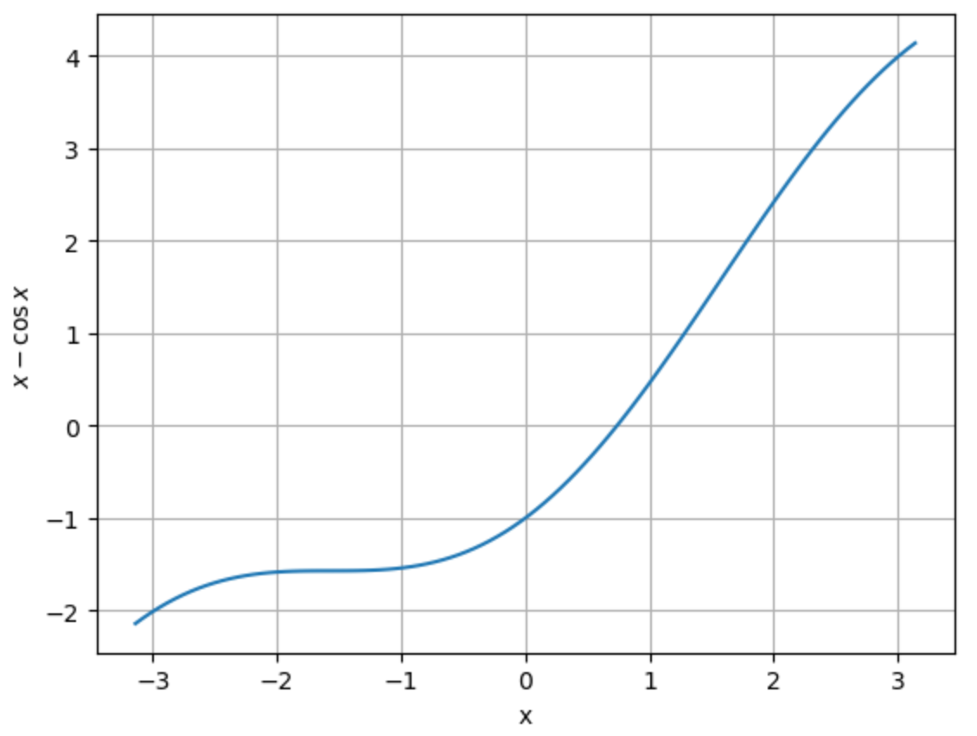
Finding Roots of an Equation
The roots of a function f(x) are all points (if any) for which
I can express any explicit or non-explicit function as a root problem. For example,
has no explicit solution for x, but it will be satisfied by the root of
Solution

Slide 3
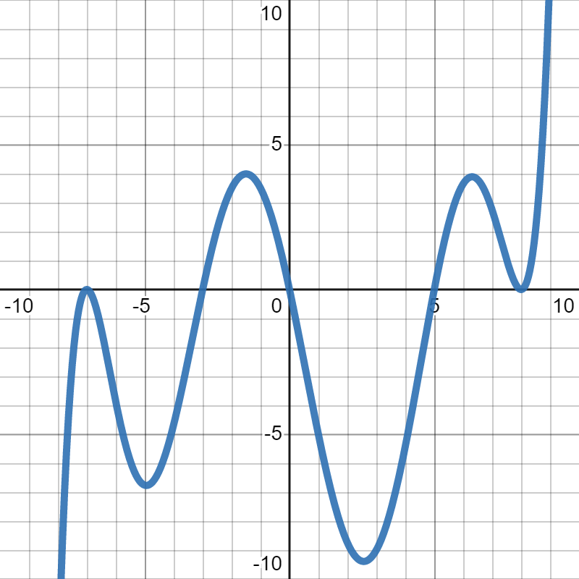
Iterations and Convergence
In general, we will iterate multiple times, each time finding a new value of x^{(i)}, presumably getting closer to the true root x*
There’s a lot of formalism for evaluating convergence, but we’ll focus on simple tests such as
Since many functions will have multiple roots,
we will usually need to start with a bracket or
at least an initial guess.

Slide 4
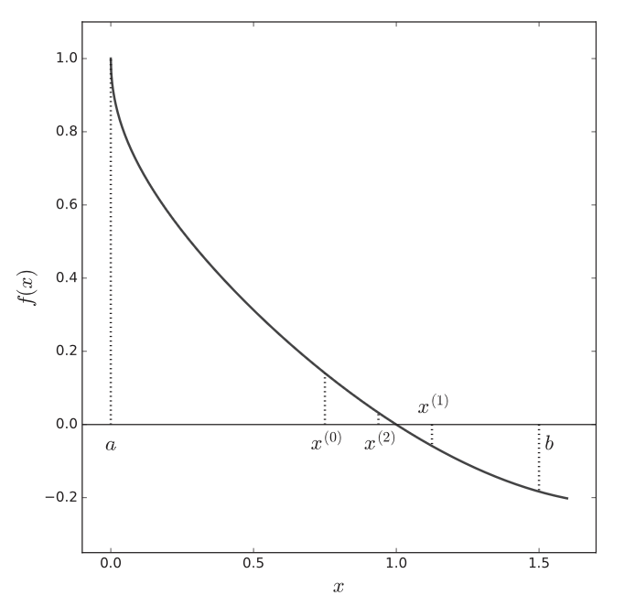
Bisection Method
We start with two points a₀ and b₀
that bracket the root; ie
Now calculate the midpoint and see which side of the root it’s on
Repeat until convergence criterion is met.

Slide 5
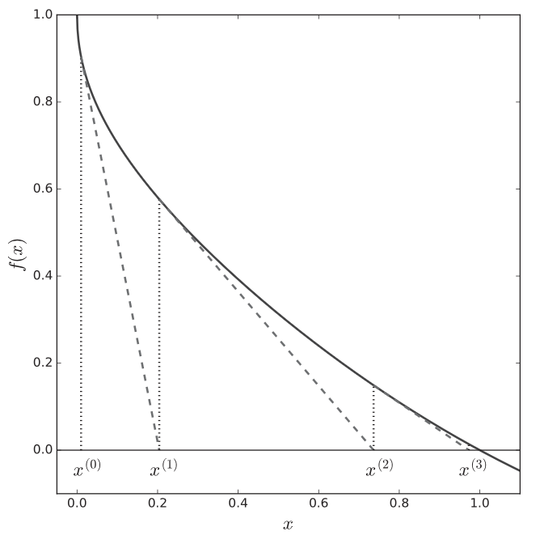
Newton’s Method
Newton’s method requires that we know the derivative of the function f’(x)
Each iteration uses the local
slope to project to the next
iteration.

Slide 6
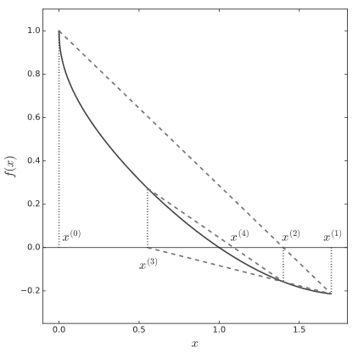
Secant Method
Similar to the Newton Method, but use
two initial guesses to approximate the
derivative
You’ll do algorithmic examples of these three methods in lab next week.

